Slide 1
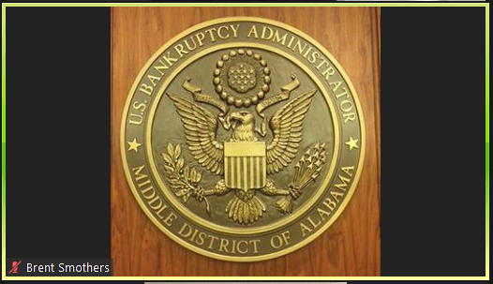

Slide 2
Zoom for Government Requirements
All Participants must have a device capable of audio, video, and internet (WiFi) to participate in a Zoom for Government meeting.
Desktop Computer with a headset and external camera
Laptop with built-in microphone (or headset) and camera
Tablet (iPad, Samsung Galaxy, Surface, LG, etc.)
Cellular phone (iPhone, Android, etc.)

Slide 3
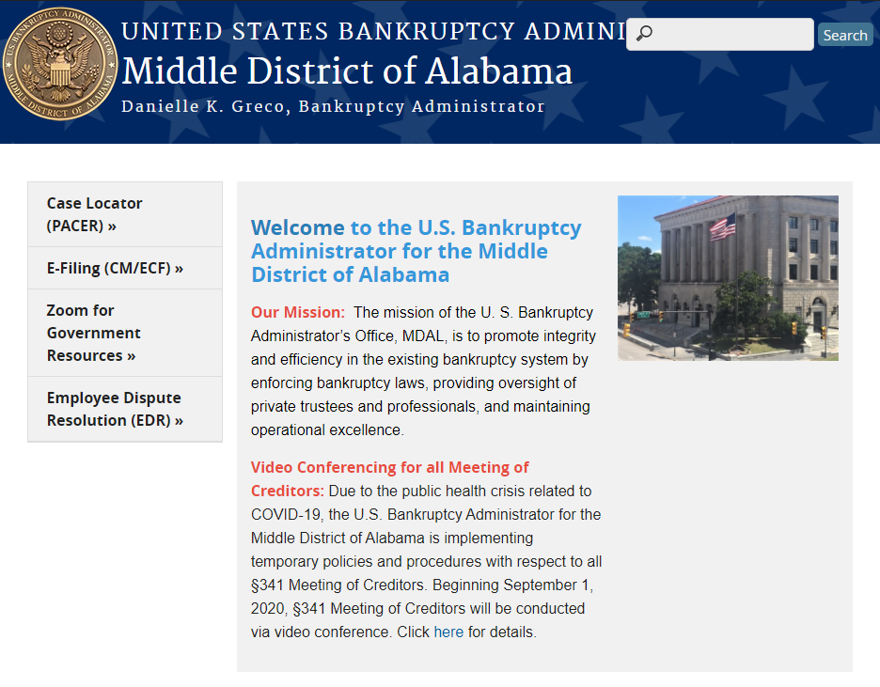
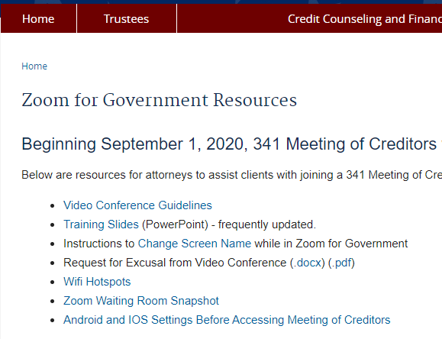
Zoom for Government Resources
Zoom for Government resources can be accessed from the
Bankruptcy Administrator’s website homepage.
Zoom Resources include Video Conference Guidelines, Training slides, Name Change
instructions, Request for Excusal from Video Conference (Word or .pdf), Wifi Hotspots, and links to the Zoom meetings for Meeting of Creditors by location.

Slide 4
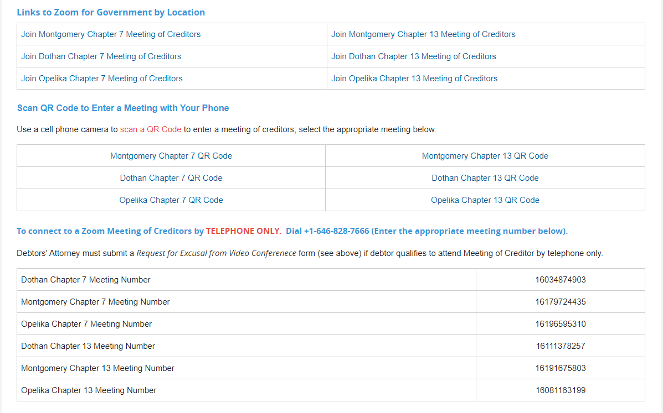
Zoom Links By Meeting Location

Slide 5
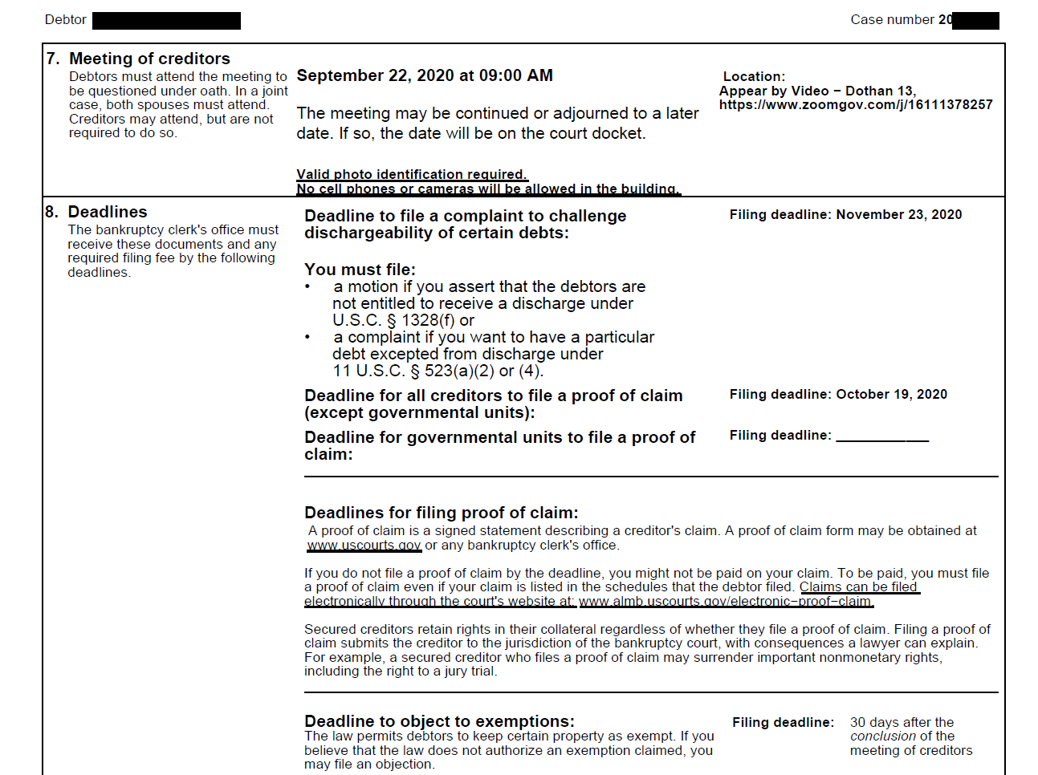

Slide 6
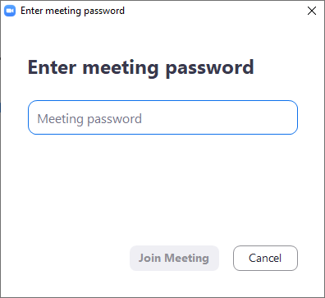
What to do if you get this?
Simply click the red X in the upper right corner.

Slide 7
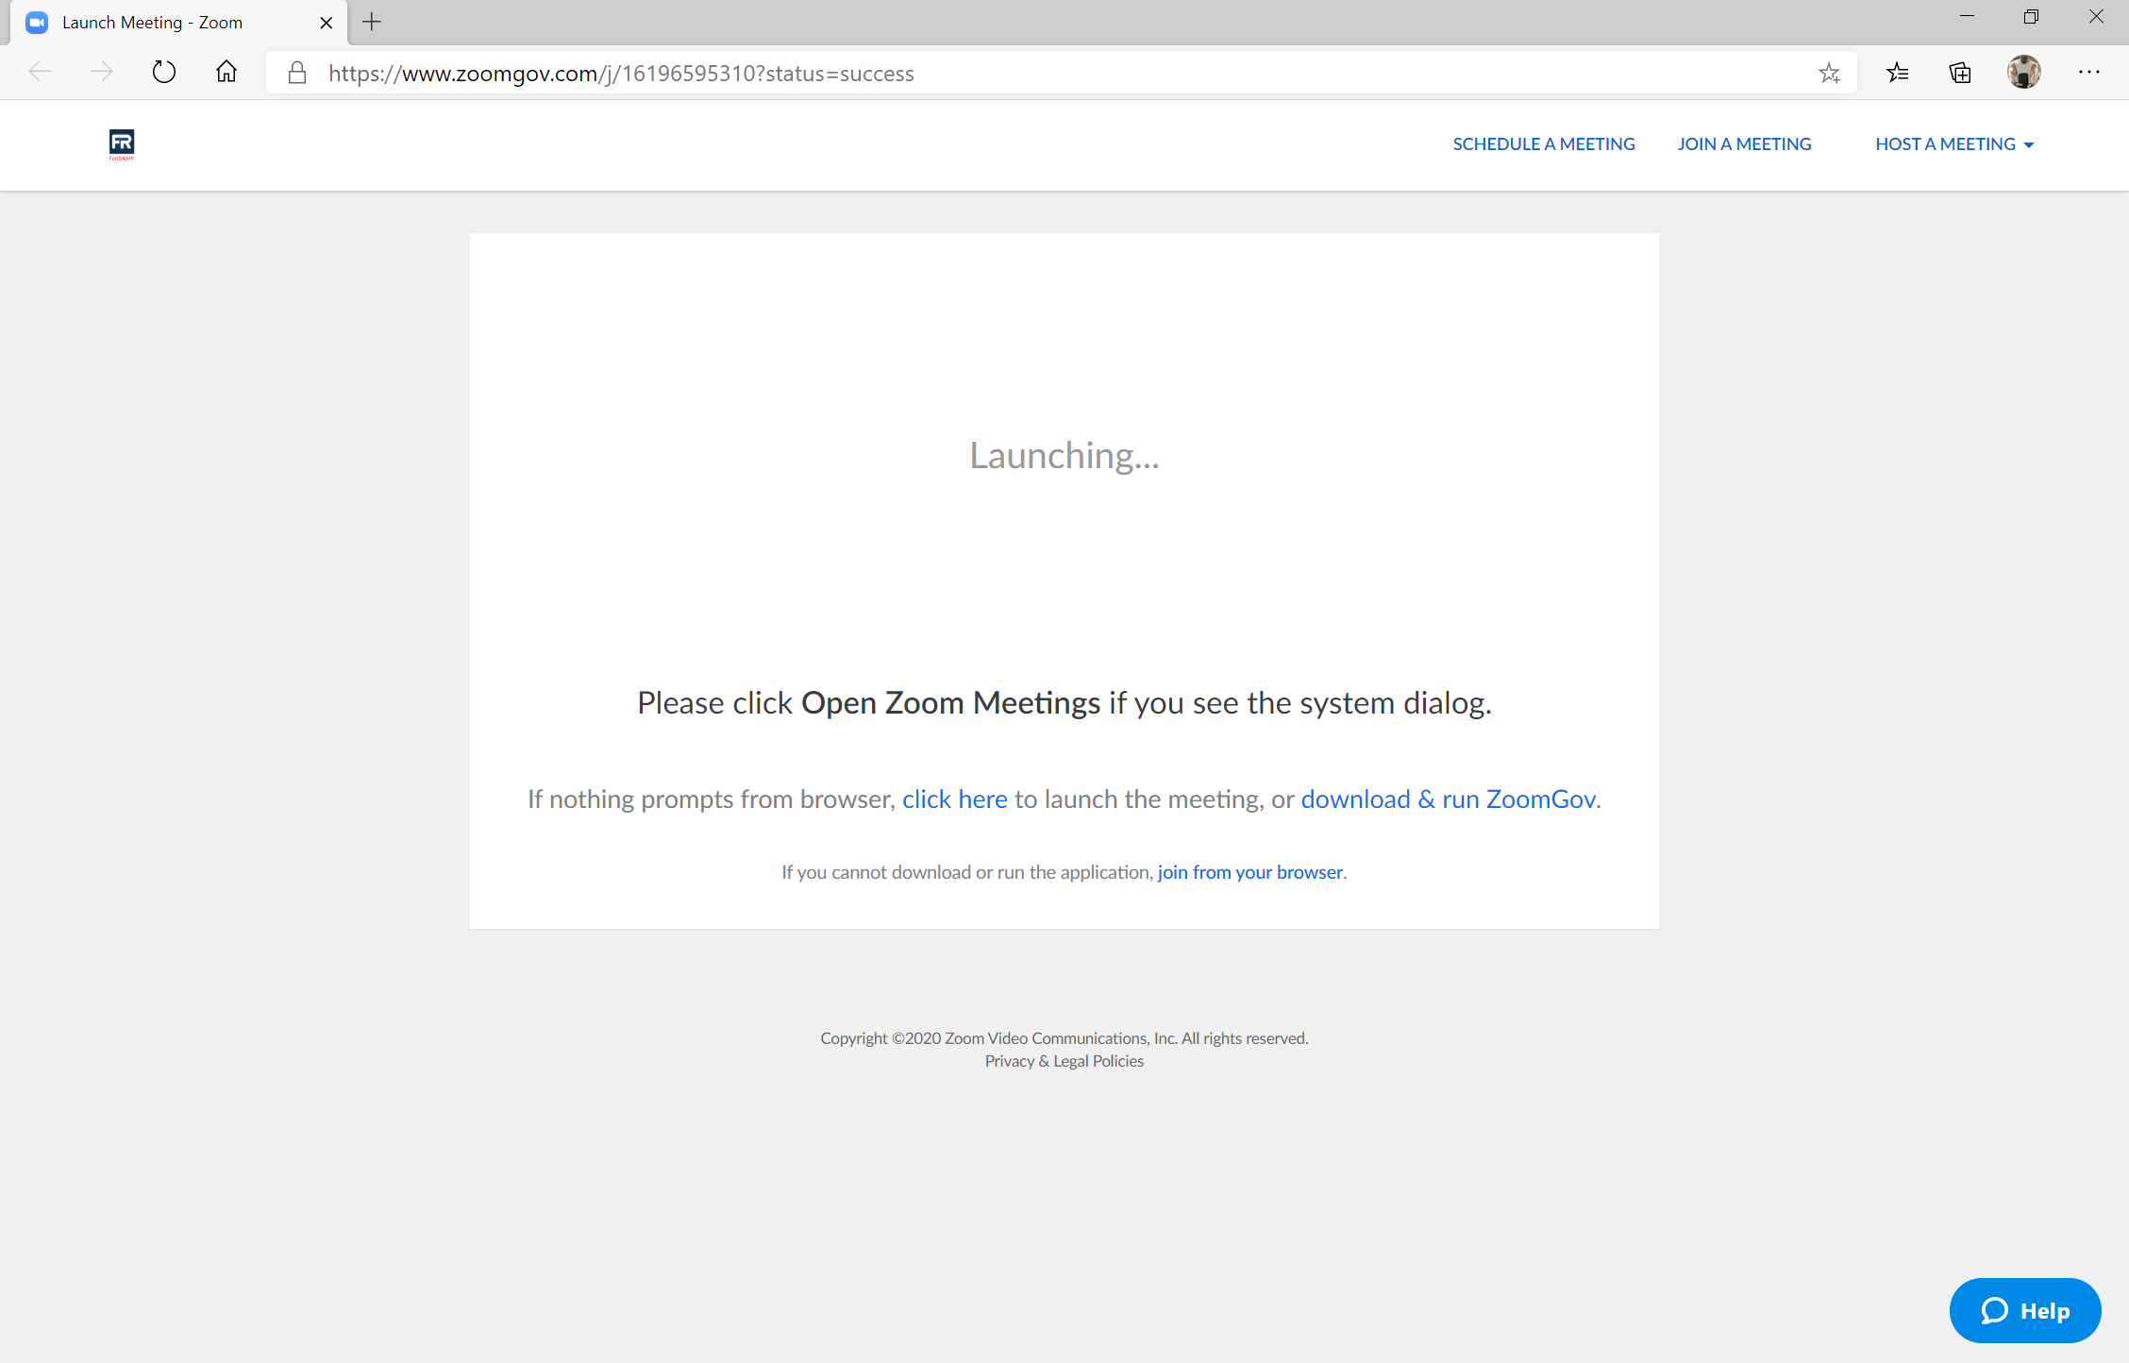
Click “join from my browser.”

Slide 8
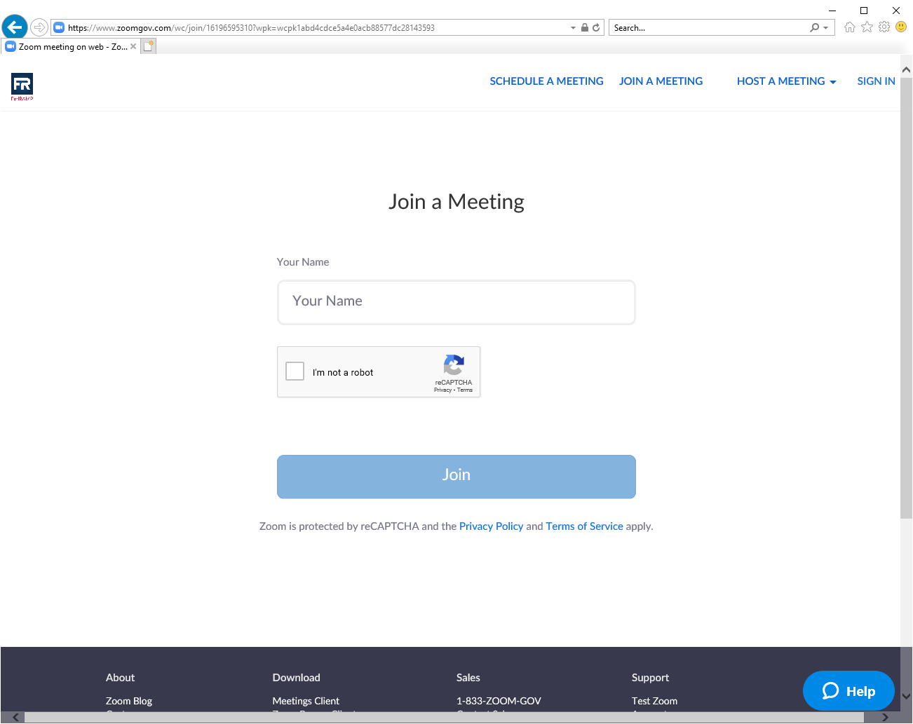
Enter Name and Case Number
All participants should update their screen name to include full name (first and Last) and, for debtors, the last five digits of their case number.
For example, John Doe with case number 20-00001 would type John Doe 00001.

Slide 9
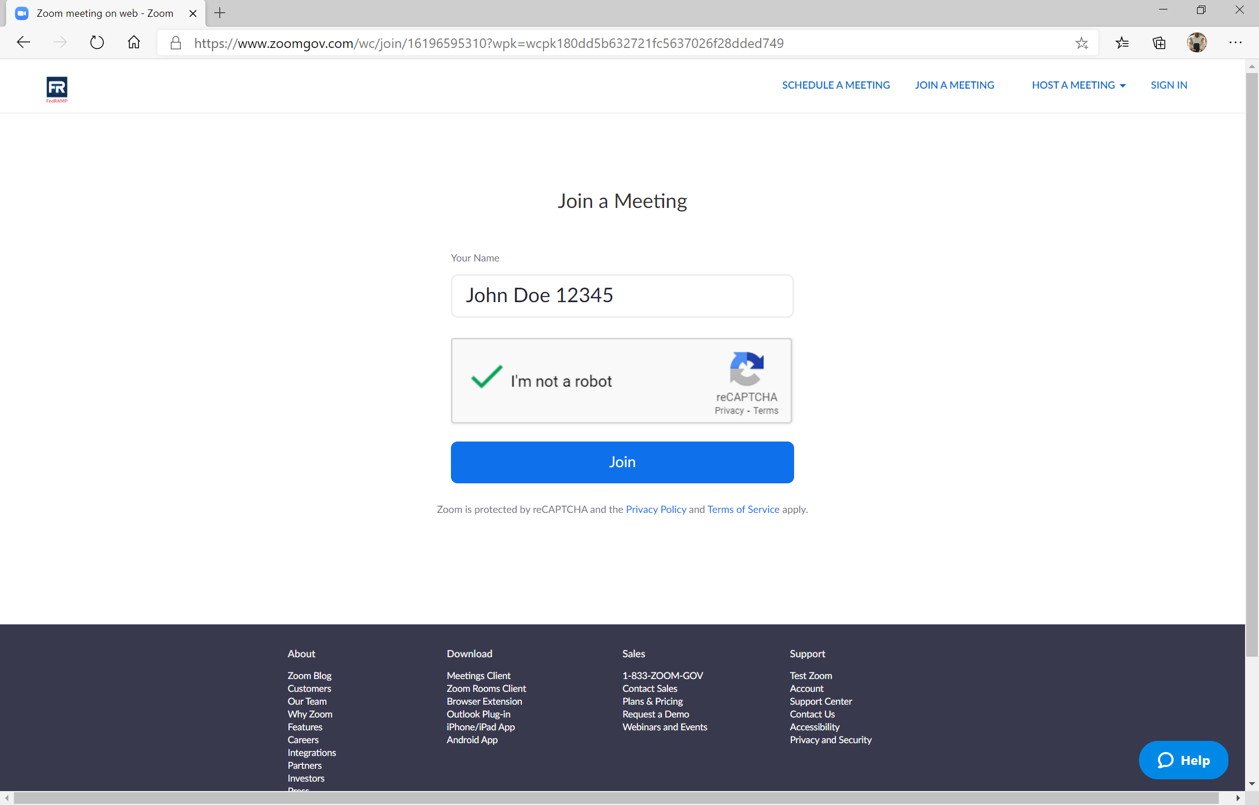
Confirm you’re not a robot and click Join.

Slide 10
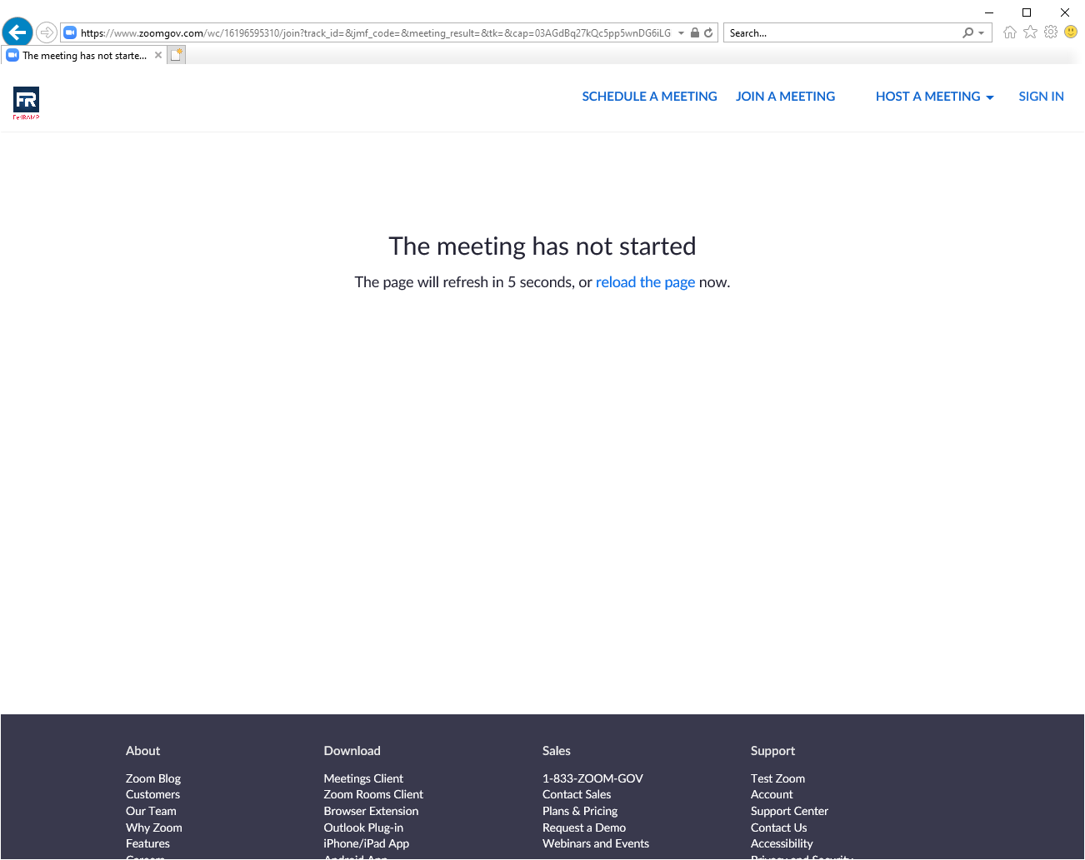
You’re in the right place! The meeting has not started.

Slide 11
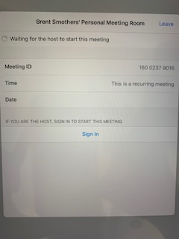
You’re in the right place! The meeting has not started.
Host (Trustee/Staff Attorney) should start
meeting early to prevent this screen.
We do not want an impatient Debtor
to start clicking links!

Slide 12
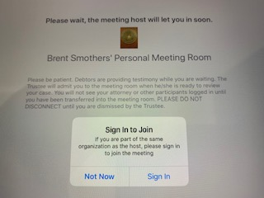
You’re in the right place! You’re in the Waiting Room.
Debtor has joined the Waiting Room
Sign In to Join prompt
Click Not Now
Participants in the Waiting Room will see the following message:
Please wait, the meeting host will let you in soon.
[BA Seal]
Dothan Chapter 7 §341 Meeting of Creditors
Please be patient. Debtors are providing testimony while you are waiting. The Trustee will admit you into the meeting room when he/she is ready to review your case. You will not see your attorney or other participants logged in until you are admitted into the meeting room. PLEASE DO NOT DISCONNECT until you are dismissed by the Trustee.

Slide 13
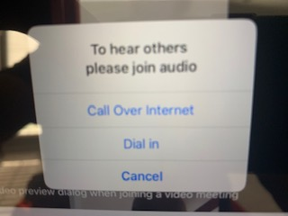
Connecting Audio
Debtor should connect using Call Over Internet
Click Call Over Internet
Dial in (phone number will be displayed)
Select the number, once connected, the audio will request a Meeting ID
And Participant ID; however, the system will enter these for you (after a brief
pause) and you DO NOT need to enter either. Once the phone connects, you
will receive a message indicating “You are in the meeting now” and you should
stay connected and go back to the Zoom meeting.

Slide 14
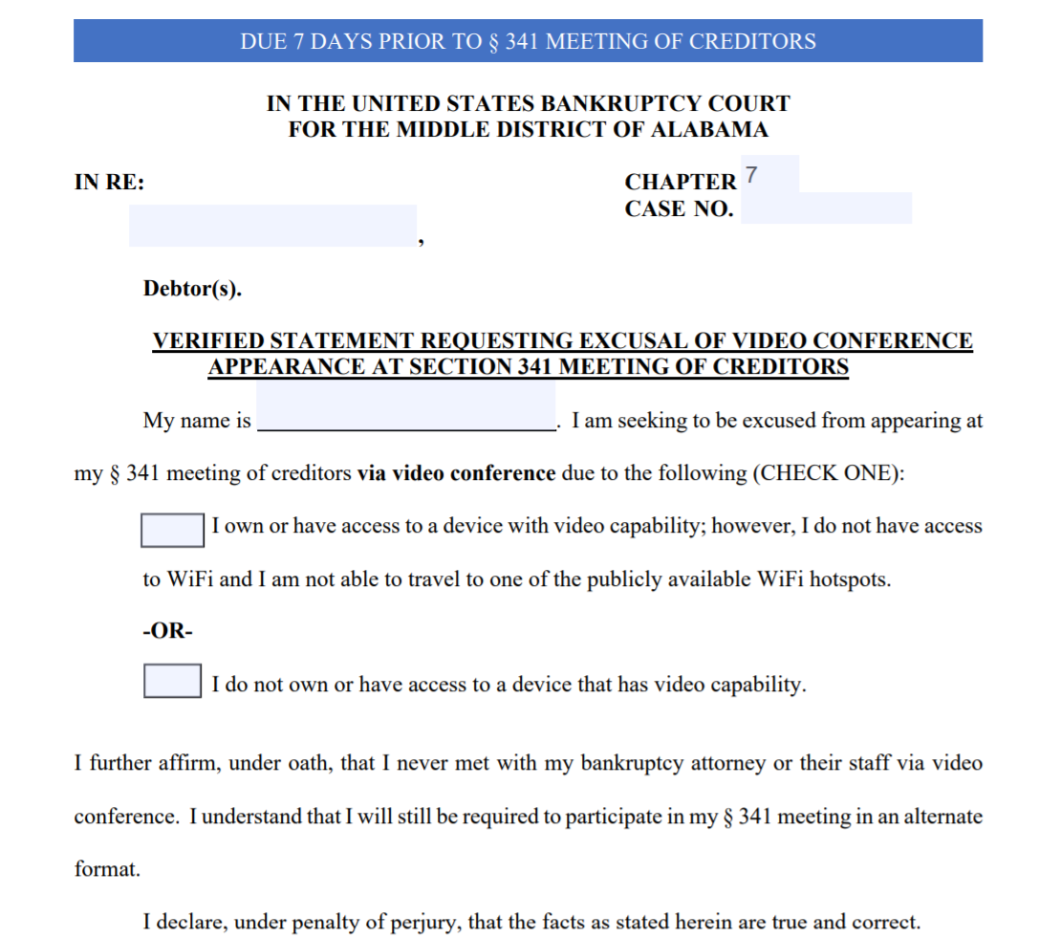
Excusal of Video Conference Appearance

Slide 15
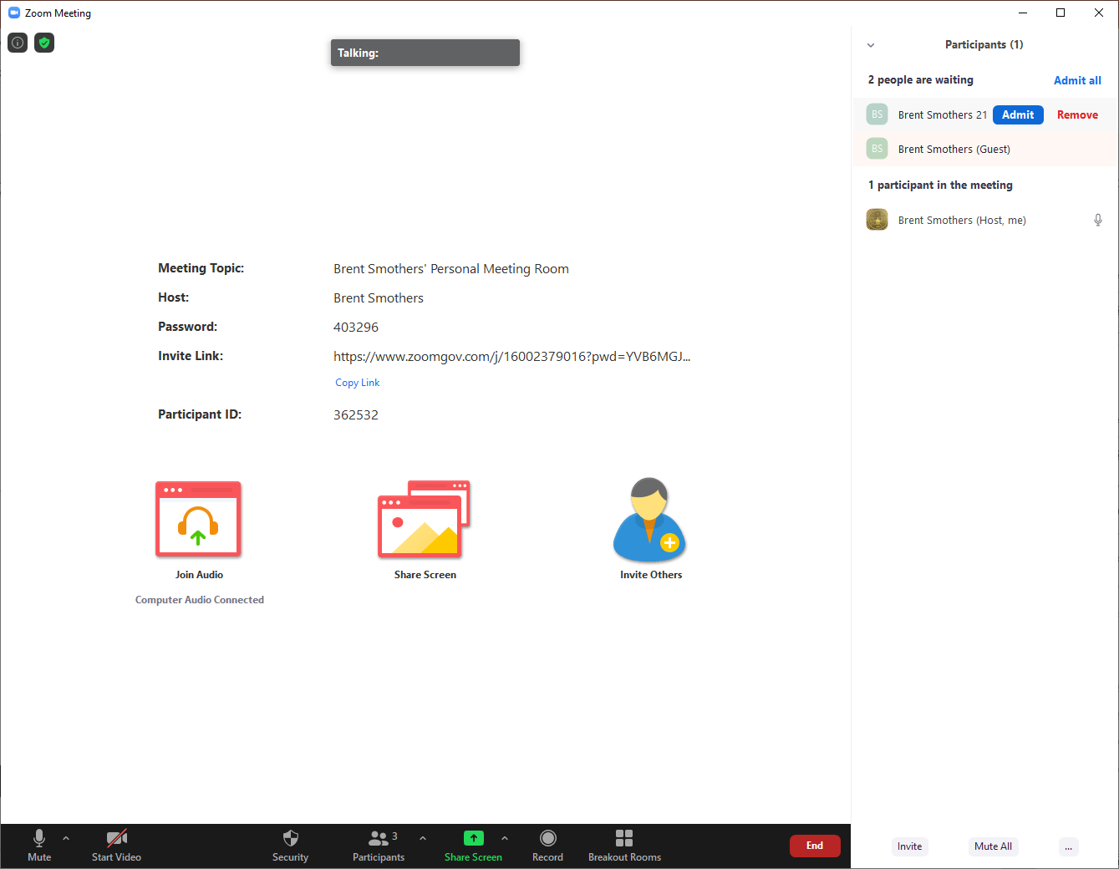
Waiting Room (WR)
1. Participants cannot hear/see others
2. Host can admit all into Meeting Room
Host can message entire Waiting Room
Host can move participants into WR
Dothan 13 Meeting of Creditors

